Slide 1
Smart Tennis Racquet Sensor
Anubhav Agarwal, Shez Malik, Robert Nelson, Lycia Tran, Rajan Vivek
Faculty Advisor: Dr. David Anderson

Slide 2
Overview
Project Description and Goals
Technical Specifications
Design Approach and Details
Project Demonstration
Marketing and Cost Analysis
Current Status
Notes:
Lycia

Slide 3
Project Description and Goals
Our goal is to increase access to high quality tennis analysis.
Create a device that attaches to any tennis racquet that classifies and logs metrics including:
Swing Type
Swing speed
Ball impact location
Our device will classify and run analysis on-device and send data to our web app for visualization.
Notes:
Lycia

Slide 4
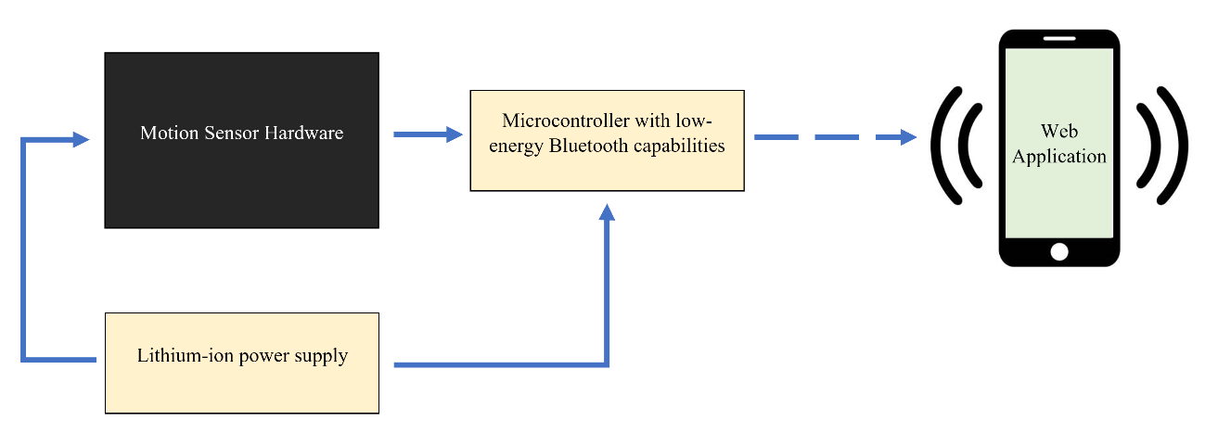
System Design
Notes:
Shez
tennis racket stuffs

Slide 5
Technical Specifications - Motion Capture
Table 1. Motion Capture Specifications
Our motion capture device must be able to handle a large amount of acceleration and capture high sudden impacts.
Item | Specification
Dual tri-axial accelerometers | ± 16g for small accelerations ± 200g for large accelerations
Tri-axial gyroscope | ± 2000°/s
Tri-axial magnetometer | ± 8 Gauss
Tri-axial barometer | 200-1100 hPa
Temperature sensor | ± 0.5 K
Sampling rate | 120-200 Hz
Power supply | 1.71-3.6 V
Accuracy | 1024-2048 LSB/g
Notes:
Anubhav
imu = inertial motion unit, gyroscope + accelerometer
technical specs talk about accelerometer specs

Slide 6
Technical Specifications - Microcontroller
In order to run our algorithms and stream their results, our microcontroller requires a minimum amount of RAM and various communication protocols.
Table 2. Microcontroller Specifications
Item | Specification
Standard library version | C++11 or newer
Platform precision | 32 bit
Communications protocols | Bluetooth LE, I2C, SPI
CPU Flash Memory | min. 16 KB
Notes:
Robby

Slide 7
Technical Specifications - Overall System
Table 3. Overall System Specifications
Our overall device has weight and size constraints in order to fit on the racquet, and our algorithms have latency and accuracy requirements.
Item | Specification
Weight | < 0.7 oz
Size | 35x25x8 mm
Casing | durable and flexible material, Epoxy
Battery | 155 mAh lithium-ion battery
Latency | 150-400ms
Shot Classification Model Performance (F1-Score) | ≥ 90%
Shot Speed Prediction Error (Root Mean Square Error) | 5 mph
Ball Collision Location Prediction Error (Root Mean Square Error) | 5 inches
Notes:
Shez
Overall system specifications, we want to make the experience as nonintrusive as possible
Our overall device has weight and size constraints in order to fit on the racquet, and our algorithms have latency and accuracy requirements.

Slide 8
Data Collection
Data Collection
Various kinds of swings in real game-play
Multiple people with different skill levels
Perhaps have an additional class for Other/Bad form swings
Ground Truth of swing speeds
Baseball radar gun
Ground Truth of location of ball collision
Divide into 4 quadrants + center (sweet spot)
Metrics
3 acceleration axes and 3 gyroscope axes
2 scales: 16 G and 200 G
Notes:
Rajan

Slide 9
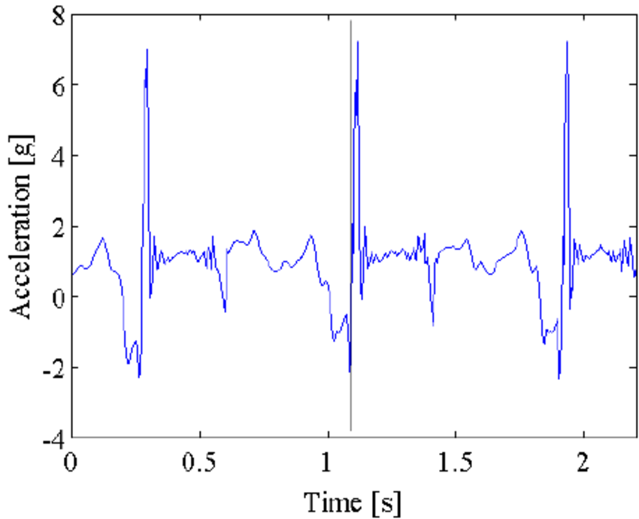
Data Processing
Activity Segmentation
When is swing happening vs. running/swing preparation
Algorithms to try:
Threshold (baseline)
Dynamic time windowing
Neural Network
Filtered acc/gyr XYZ values
FFT data
Convolutional Neural Network
1D kernels for each acc/gyr XYZ
Activity Recognition
NN and CNN
Long-Short Term Memory Network?
Notes:
Rajan

Slide 10
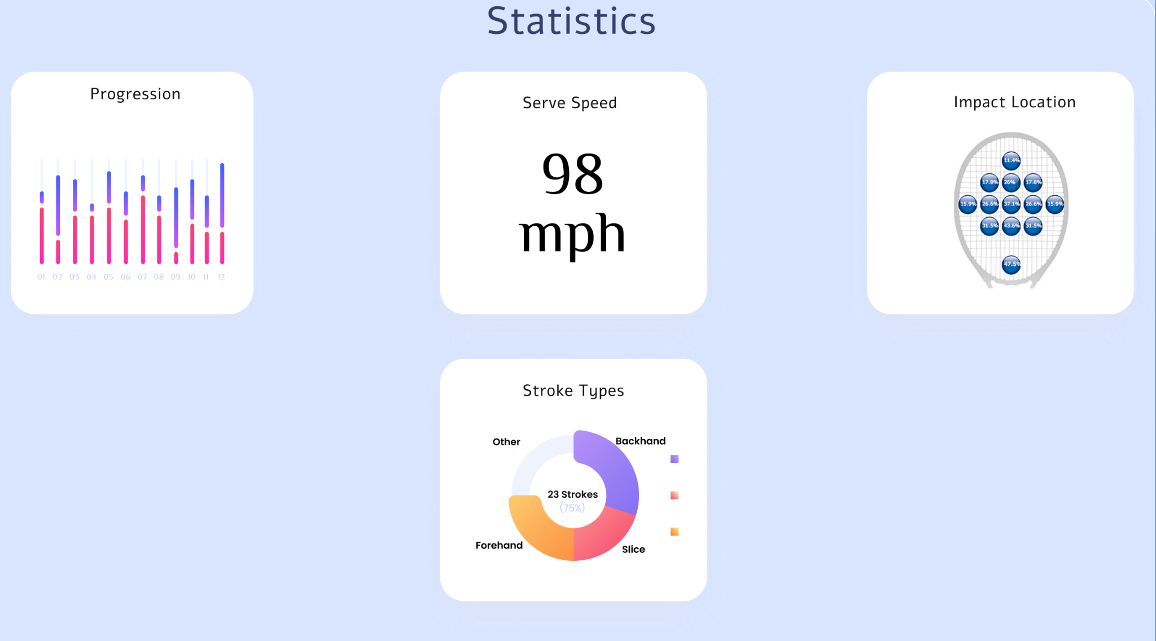
Project Demonstration
Before the expo, we intend to test our product in a real tennis game. This
can be done with the help of recreational or professional tennis players.
For the expo, we intend to demo our product by having a team member
swing the racquet. We will have our web app streaming to a display
allowing judges to view the results in real time.
Notes:
Lycia

Slide 11
Marketing and Cost Analysis
Component | Estimated Cost
Microcontroller with ± 16 G accelerometer | $20.00
3D Printed Packaging | $0.50
Lithium Ion battery and Charger | $13.00
Epoxy Casing | $0.50
± 200 G absolute orientation sensor with gyroscope, magnetometer, barometer and temperature sensor | $15.00
Total | $49.00
Total Projected Cost: $49.00
Notes:
Anubhav

Slide 12
Current Status
High impact bluetooth disconnect problem solved
Attributed to poor battery connections in the spring mechanism
Switched to LiPo design with soldered connections to proto board
Data collection at the courts on Saturday
Still processing and looking through the data
Current issues
Dropped bluetooth packets when the range is greater than ~ 10ft
Data logger breakout has been ordered for SD card integration
Other efforts
Web app starting this week
Notes:
Robby

Slide 13
References
[1] Find Tennis Lessons, “Find tennis lessons: Find tennis coaches: Find tennis instructors,”
FindTennisLessons.com, 07-May-2021. [Online]. Available:
https://www.findtennislessons.com/. [Accessed:08-Oct-2021].
[2] Allied Market Research, “Smart Sports Equipment Market Size & Growth: Industry
Forecast, 2026,” alliedmarketresearch.com [Online]. Available: https://www.alliedm
arketresearch.com/smart-sports-equipment-market. [Accessed: 23-Nov-2021].
[3] E. M. Keaney, and M. Reid, “Quantifying hitting activity in tennis with racket sensors:
new dawn or false dawn?,” Sports Biomechanics, vol. 19, no. 6, Dec., pp. 831-839,
2020.
[4] “Smart Technology to help you transform your health,” fitbit.com, Nov. 22, 2021.
[Online]. Available: https://www.fitbit.com/global/us/technology. [Accessed:
22-Nov-2021].
[5] “Zepp Tennis Swing Analyzer: Sports & Outdoors,” Amazon.com. [Online]. Available:
https://www.amazon.com/-/es/ZA1T2NA-Zepp-Tennis-Swing-Analyzer/dp/B00IIF6P
E. [Accessed: 08-Oct-2021].
Notes:
Rajan

Slide 14
Questions?
Notes:
Shez

